Slide 1
Java Swing

Slide 2
AWT to Swing
AWT: Abstract Windowing Toolkit
    import java.awt.*
Swing: new with Java2
    import javax.swing.*
    Extends AWT
    Tons o’ new improved components
    Standard dialog boxes, tooltips, …
    Look-and-feel, skins
    Event listeners
API:
    http://java.sun.com/j2se/1.3/docs/api/index.html

Slide 3
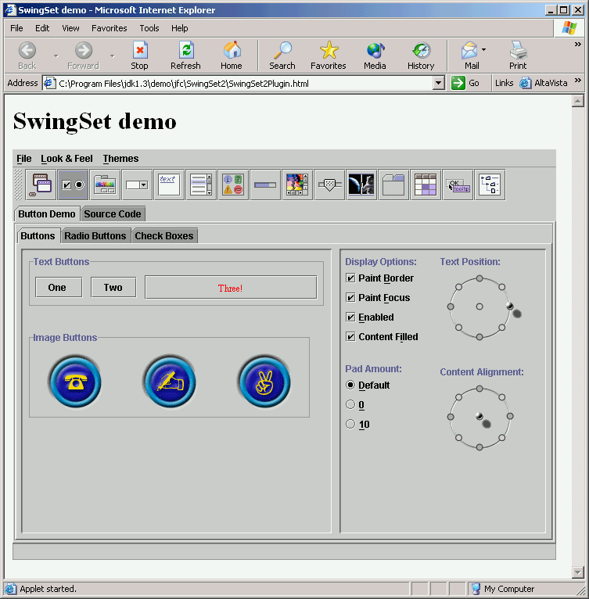
Swing Set Demo
http://java.sun.com/products/plugin/1.4/demos/plugin/jfc/SwingSet2/SwingSet2.html
Many predefined
GUI components

Slide 4
GUI Component API
Java: GUI component = class
Properties
Methods
Events
JButton

Slide 5
Using a GUI Component
Create it
    Instantiate object: b = new JButton(“press me”);
Configure it
    Properties: b.text = “press me”; [avoided in java]
    Methods: b.setText(“press me”);
Add it
    panel.add(b);
Listen to it
    Events: Listeners
JButton

Slide 6
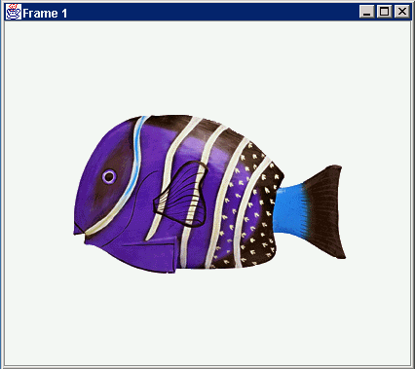
Anatomy of an Application GUI
GUI
Internal structure
JFrame
JFrame
JPanel
containers
JPanel
JButton
JButton
JLabel
JLabel

Slide 7
Using a GUI Component 2
Create it
Configure it
Add children (if container)
Add to parent (if not JFrame)
Listen to it
order
important

Slide 8
Build from bottom up
Listener
Create:
    Frame
    Panel
    Components
    Listeners
Add: (bottom up)
    listeners into components
    components into panel
    panel into frame
JLabel
JButton
JPanel
JFrame

Slide 9
Code
JFrame f = new JFrame(“title”);
JPanel p = new JPanel( );
JButton b = new JButton(“press me”);
p.add(b); // add button to panel
f.setContentPane(p); // add panel to frame
f.show();
press me

Slide 10
Application Code
import javax.swing.*;
class hello {
public static void main(String[] args){
JFrame f = new JFrame(“title”);
JPanel p = new JPanel();
JButton b = new JButton(“press me”);
p.add(b); // add button to panel
f.setContentPane(p); // add panel to frame
f.show();
}
}
press me

Slide 11
Introduction to Swing
A GUI is constructed from:
  Components or widgets:
    Defined in javax.swing package
    Examples: windows, buttons, labels, text fields, menus, scroll bars, …
    Abstract class JComponent
  Containers:
    A GUI component that can contain other components
    A top-level container is not contained in any other container (example: JFrame)

Slide 12

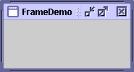
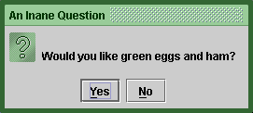
Top-Level Swing Components
Top level components are designed to hold multiple lower-level components
  Applets, dialogs, and frames
    javax.swing.JApplet, .JDialog, and .JFrame
Most Swing applications start with a Frame
  it’s actually called a javax.swing.JFrame (J is for Java)
When you draw graphics, you always need to draw onto some kind of container.

Slide 13
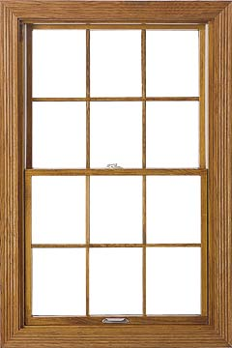
Example: Panels
JFrames hold JPanels
  think of a JFrame as a window frame
  think of a JPanel as a window pane
Panels are the canvas for your program
  in Swing, they are called javax.swing.JPanels
  panels draw graphical shapes and GUI elements
  we can add panels to a frame, and then add shapes and GUI elements to the panels
Frame
Panel
sub-panels

Slide 14
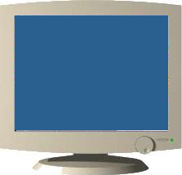


Painting components
How do we draw components on screen?
  just add component to JPanel
    call add()…
  Java developers already defined paintComponent method for all GUI components (i.e., JButtons, etc…)
    do NOT have to override paintComponent
Chain of command
  add JButton to JFrame
  call setVisible(true) on JFrame
  then your GUI gets painted in 3 easy steps!
    Step 1: Swing calls paintComponent on JFrame
    Step 2: JFrame calls paintComponent on JPanel
    Step 3: JPanel calls paintComponent on JButton

Slide 15
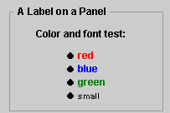
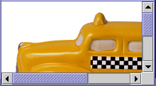



General Purpose Containers
Used inside a top-level container to group other components
  Panels and panes
    JPanel
    JScrollPane
    JSplitPane
    JTabbedPane
    JToolBar

Slide 16
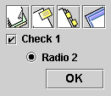

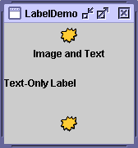


Basic Controls
Atomic Widgets generally used for user input or program output
  Buttons, menus, text fields, labels, etc.
    JButton
    JList
    JSlider
    JLabel
    JTextField
Only a few examples are listed

Slide 17
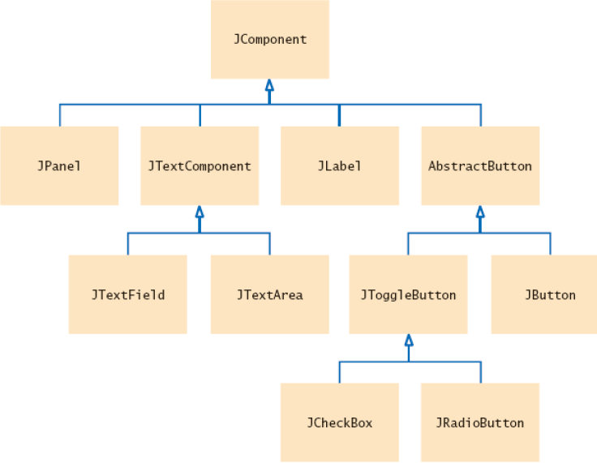
Swing hierarchy and GUI components
Event-driven programming with Swing library:
  Classes you define will be derived classes of the Swing library classes, which will inherit methods from their base class.
  Most of the time, you will override the definition of the inherited methods.
A Part of the Hierarchy of Swing User Interface Components

Slide 18
Layout Managers
Automatically control placement of components in a panel
Why?

Slide 19
Layout Manager Heuristics
null
FlowLayout
GridLayout
none,
programmer
sets x,y,w,h
Left to right,
Top to bottom
BorderLayout
CardLayout
GridBagLayout
n
c
One at a time
w
e
JButton
s

Slide 20
Combinations
JButton
JButton
JTextArea

Slide 21
Combinations
JButton
JButton
JFrame
n
JPanel: BorderLayout
c
JPanel: FlowLayout
JTextArea

Slide 22
Code: null layout
JFrame f = new JFrame(“title”);
JPanel p = new JPanel( );
JButton b = new JButton(“press me”);
b.setBounds(new Rectangle(10,10, 100,50));
p.setLayout(null); // x,y layout
p.add(b);
f.setContentPane(p);
press me

Slide 23
Code: FlowLayout
JFrame f = new JFrame(“title”);
JPanel p = new JPanel( );
FlowLayout L = new FlowLayout( );
JButton b1 = new JButton(“press me”);
JButton b2 = new JButton(“then me”);
p.setLayout(L);
p.add(b1);
p.add(b2);
f.setContentPane(p);
Set layout mgr before adding components
press me
then me

